Slide 1

Application Layer
Dr. Firoz Ahmed
Associate Professor
Department of ICE, RU
November 1st, 2017

Slide 2

OutLine
Client-Server Model
Domain Name System (DNS)
Electronic mail (SMTP) and File Transfer (FTP)
HTTP and WWW

Slide 3
Client-Server Model
Two remote application process can communicate in mainly two different fashions
  Peer-to-peer
    Both remote processes are at same level and exchange data using some shared resource
  Client-Server
    One the remote process acts as Client and requests some resource from another application process acting as Server

Slide 4
Client-Server Model
A client-server system consists of a server system and (one or more) client subsystems
In the client/server model
  The device requesting the information is called a client and the device responding to the request is called a server
Client and server processes are considered to be in the Application layer
The client begins the exchange by requesting data from the server, which responds by sending one or more streams of data to the client
Application layer protocols describe the format of the requests and responses between clients and servers

Slide 5
Client-Server Model
In client-server model, any process can act as Server or Client
This is not the machine or size of the machine or its computing power which makes it server
  It is the feature of serving request that makes it server
A system can act as Server and Client simultaneously
That is, one process is acting as Server and another is acting as a client
This may also happen that both client and server processes reside on the same machine

Slide 6
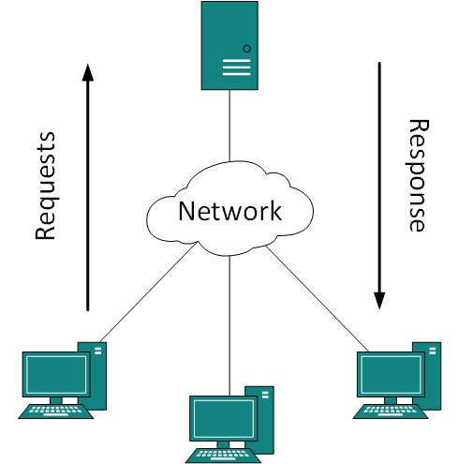
Client-Server Model
Two processes in client-server model can interact in various ways
  Sockets
  Remote Procedure Calls (RPC)

Slide 7
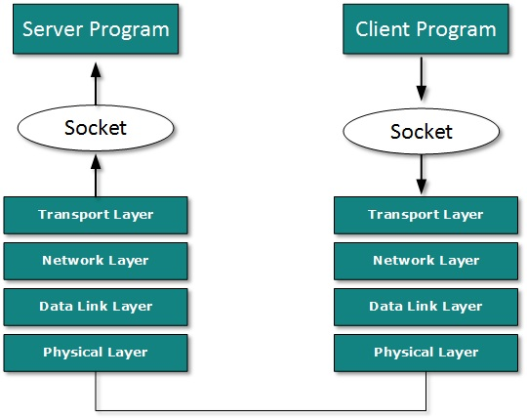
Sockets
In this paradigm, the process acting as Server opens a socket using a well-known port and waits until some client request comes
The second process acting as Client also opens a socket but instead of waiting for an incoming request, client process ‘requests first’
When the request is reached to server, it is served. It can either be an information sharing or resource request

Slide 8
Remote Procedure Calls (RPC)
This is a mechanism where one process interacts with another by means of procedure calls
One process (client) calls the procedure lying on remote host
The process on remote host is said to be Server

Slide 9
Domain Name System (DNS)
The Domain Name System (DNS) is a supporting program that is used by other programs such as e-mail
A DNS client/server program can support an e-mail program to find the IP address of an e-mail recipient
A user of an e-mail program may know the e-mail address of the recipient
However, the IP protocol needs the IP address
The DNS client program sends a request to a DNS server to map the e-mail address to the corresponding IP address

Slide 10
Domain Name System (DNS)
To identify an entity, TCP/IP protocols use the IP address
However, people prefer to use names instead of numeric addresses
Therefore, we need a system that can map a name to an address or an address to a name

Slide 11


Domain Name System (DNS)
Example of using the DNS service

Slide 12
Outline
Name Space
Domain Name Space
Distribution of Name Space
DNS in the Internet
Resolution
DNS Messages
Types of Records
Registrars
Dynamic Domain Name System (DDNS)
Encapsulation

Slide 13
Name Space
The names must be unique because the addresses are unique
A name space that maps each address to a unique name can be organized in two ways
  Flat
  Hierarchical

Slide 14

Domain Name Space
To have a hierarchical name space, a domain name space was designed
In this design the names are defined in an inverted-tree structure with the root at the top
The tree can have only 128 levels: level 0 (root) to level 127

Slide 15

Domain Name Space
Label
  Each node in the tree has a label, which is a string with a maximum of 63 characters
  Different labels guarantees the uniqueness of the domain names
Domain Name
  Each node in the tree has a domain name
  A full domain name is a sequence of labels separated by dots (.)
  The domain names are always read from the node up to the root

Slide 16
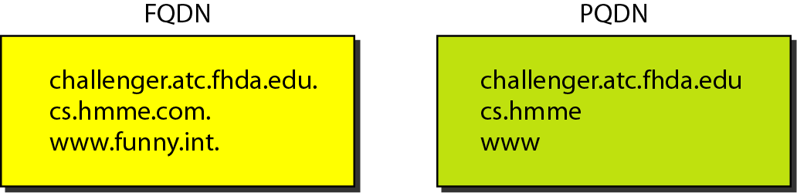
Domain Name Space
Fully Qualified Domain Name (FQDN)
  If a label is terminated by a null string, it is called FQDN
  An FQDN is a domain name that contains the full name of a host
        challenger.ate.tbda.edu.
Partially Qualified Domain Name (PQDN)
  If a label is not terminated by a null string, it is called PQDN
  A PQDN starts from a node, but it does not reach the root

Slide 17
DNS in the Internet
DNS is a protocol that can be used in different platforms
In the Internet, the domain name space is divided into three different sections
  Generic domains
  Country domains
  The inverse domain

Slide 18

DNS in the Internet
Generic Domains
  The generic domains define registered hosts according to their generic behavior
  Each node in the tree defines a domain, which is an index to the domain name space database

Slide 19

DNS in the Internet
Country Domains
  The country domains section uses two-character country abbreviations (e.g., us for United States)

Slide 20

DNS in the Internet
Inverse Domain
  The inverse domain is used to map an address to a name

Slide 21
DNS MESSAGES
DNS has two types of messages
  Query
  Response
Both types have the same format
The query message consists of a header and question records;
the response message consists of a header, question records, answer records, authoritative records, and additional records

Slide 22
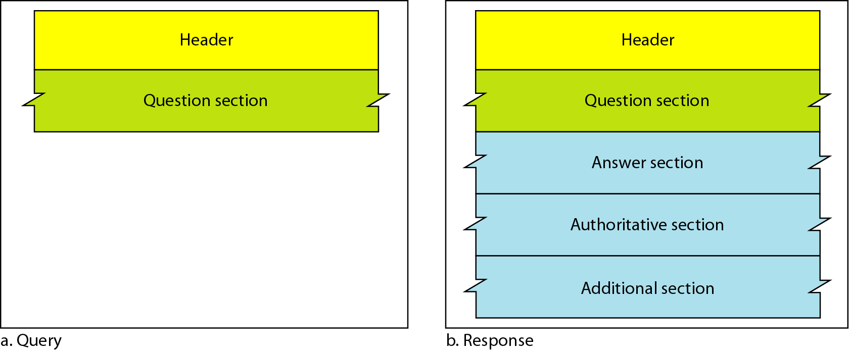
DNS MESSAGES

Slide 23
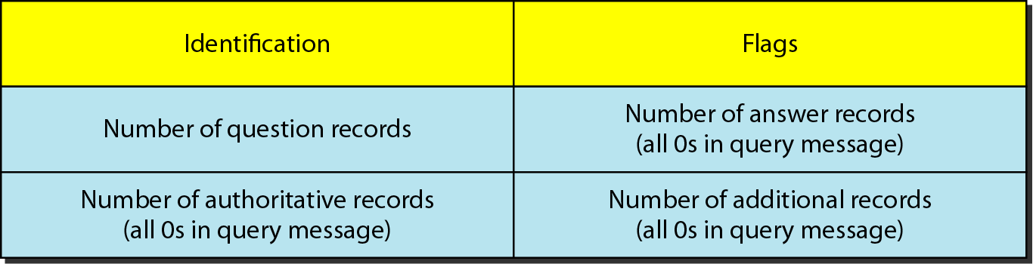
DNS MESSAGES
Header
  Both query and response messages have the same header format with some fields set to zero for the query messages
  The header is 12 bytes

Slide 24
DNS MESSAGES
Identification
  The identification subfield is used by the client to match the response with the query
  The client uses a different identification number each time it sends a query
  The server duplicates this number in the corresponding response
Flags
  The flags subfield is a collection of subfields that define the type of the message, answer requested, desired resolution and so on
Number of question records
  It contains the number of queries in the question section of the message

Slide 25
DNS MESSAGES
Number of answer records
  It contains the number of answer records in the answer section of the response message
Number of authoritative records
  It contains the number of authoritative records in the authoritative section of a response message
Number of additional records
  It contains The number additional records in the additional section of a response message

Slide 26
DNS MESSAGES
Question Section
  It consist of one or more question records
  It is present on both query and response messages
Answer Section
  It consist of one or more resource records
  It is present only on response messages
  This section includes the answer from the server to the client
Authoritative Section
  It gives information about one or more authoritative server for the query
Additional information Section
  It provides additional information that may help the client

Slide 27
Dynamic Domain Name System (DDNS)
When the DNS was designed, no one predicted that there would be so many addresses changes
When there is a changes, the change must be made to the DNS master file
The DNS master file must be updated dynamically
Therefore DDNS was devised to respond to this need
To provide security and prevent unauthorized changes in the DNS records, DDNS can use an authentication mechanism

Slide 28
Electronic mail
One of the most popular Internet services is electronic mail (e-mail)
At the beginning of the Internet era, the messages sent by electronic mail were short and consisted of text only
Today, electronic mail is much more complex
It allows a message to include text, audio, and video
It also allows one message to be sent to one or more recipients

Slide 29
Electronic mail
The general architecture of an e-mail system including the three main components
  User agent
  Message transfer agent
  Message access agent

Slide 30

Electronic mail (First Scenario)

Slide 31
Electronic mail (First Scenario)
The sender and the receiver of the e-mail are users on the same system
They are directly connected to a shared system
The administrator has created one mailbox for each user where the received messages are stored
Only the owner of the mailbox has access to it
When Alice needs to send a message to Bob, Alice runs a user agent (UA) program to prepare the message and store it in Bob's mailbox
Bob can retrieve and read the contents of his mailbox, using a user agent

Slide 32

Electronic mail (Second Scenario)

Slide 33
Electronic mail (Second Scenario)
The sender and the receiver of the e-mail are users on two different systems
The message needs to be sent over the Internet
We need user agents (UAs) and message transfer agents (MTAs)
Alice needs to use a user agent program to send her message to the system at her own site
Bob also needs a user agent program to retrieve messages stored in the mailbox of the system at his site
The message needs to be sent through the Internet from Alice's site to Bob's site

Slide 34

Electronic mail (Third Scenario)

Slide 35
Electronic mail (Third Scenario)
Bob is directly connected to his system
Alice, however, is separated from her system
Either Alice is connected to the system via a point-to-point WAN or LAN
Alice still needs a user agent to prepare her message
She then needs to send the message through the LAN or WAN

Slide 36
Electronic mail (Third Scenario)
Whenever Alice has a message to send, she calls the user agent which, in turn, calls the MTA client
The MTA client establishes a connection with the MTA server on the system
The system at Alice's site queues all messages received
It then uses an MTA client to send the messages to the system at Bob's site
The system receives the message and stores it in Bob's mailbox

Slide 37

Electronic mail (Fourth Scenario)

Slide 38
Electronic mail (Fourth Scenario)
Bob is also connected to his mail server by a WAN or a LAN
After the message has arrived at Bob's mail server, Bob needs to retrieve it
We need another set of client/server agents, which we call message access agents (MAAs)
Bob uses an MAA client to retrieve his messages
The client sends a request to the MAA server and requests the transfer of the messages

Slide 39
Electronic mail (Fourth Scenario)
There are two important points here
  First, Bob cannot bypass the mail server and use the MTA server directly
  To use MTA server directly, Bob would need to run the MTA server all the time because he does not know when a message will arrive
  This implies that Bob must keep his computer on all the time if he is connected to his system through a LAN
  If he is connected through a-WAN, he must keep the connection up all the time

Slide 40

Electronic mail (Fourth Scenario)
Second, note that Bob needs another pair of client/server programs: message access programs
This is so because an MTA client/server program is a push program: the client pushes the message to the server
Bob needs a pull program. The client needs to pull the message from the server

Slide 41
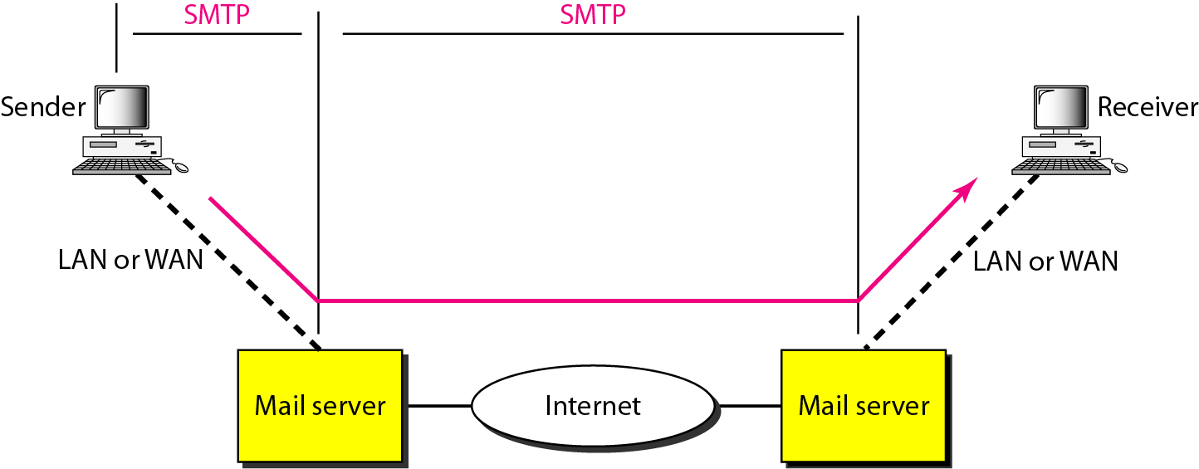
Message Transfer Agent: SMTP
The actual mail transfer is done through message transfer agents
To send mail, a system must have the client MTA, and to receive mail, a system must have a server MTA
The formal protocol that defines the MTA client and server in the Internet is called the SMTP

Slide 42

Message Transfer Agent: SMTP
Discuss the mechanism of mail transfer by SMTP
  Commands and Responses
    SMTP uses commands and responses to transfer messages between an MTA client and an MTA server

Slide 43

Message Transfer Agent: SMTP
Commands
  Commands are sent from the client to the server
  It consists of a keyword followed by zero or more arguments
  SMTP defines 14 commands
  The first five are mandatory
  The next three are often used and highly recommended
  The last six are seldom used

Slide 44
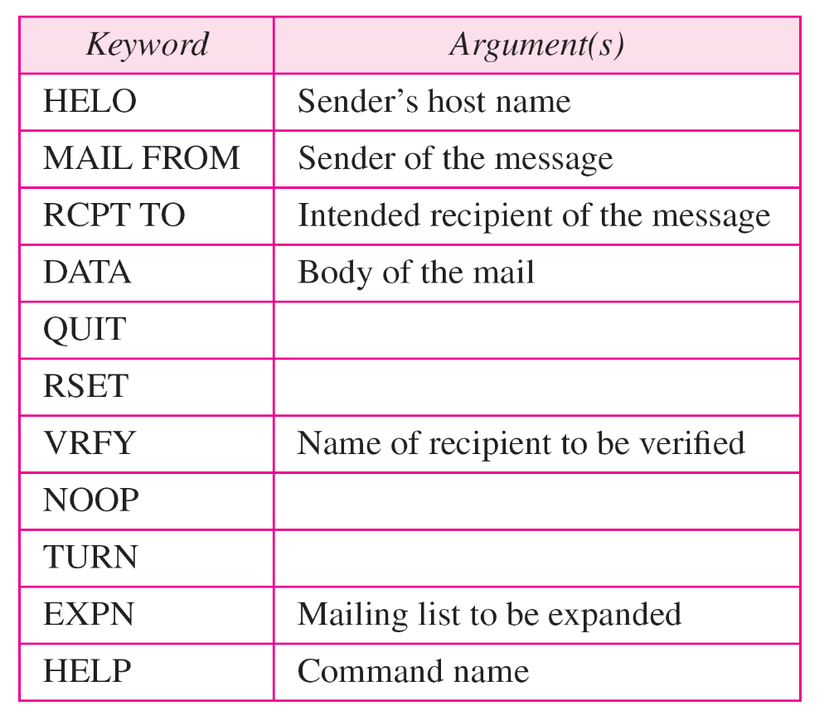
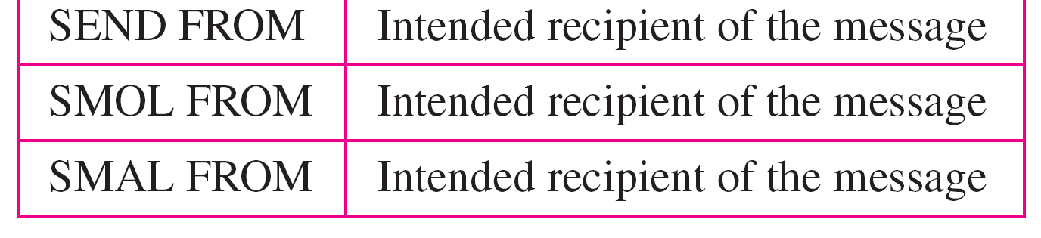
Message Transfer Agent: SMTP

Slide 45
Message Transfer Agent: SMTP
Responses
  Responses are sent from the server to the client
  A response is a three digit code that may be followed by additional textual information

Slide 46
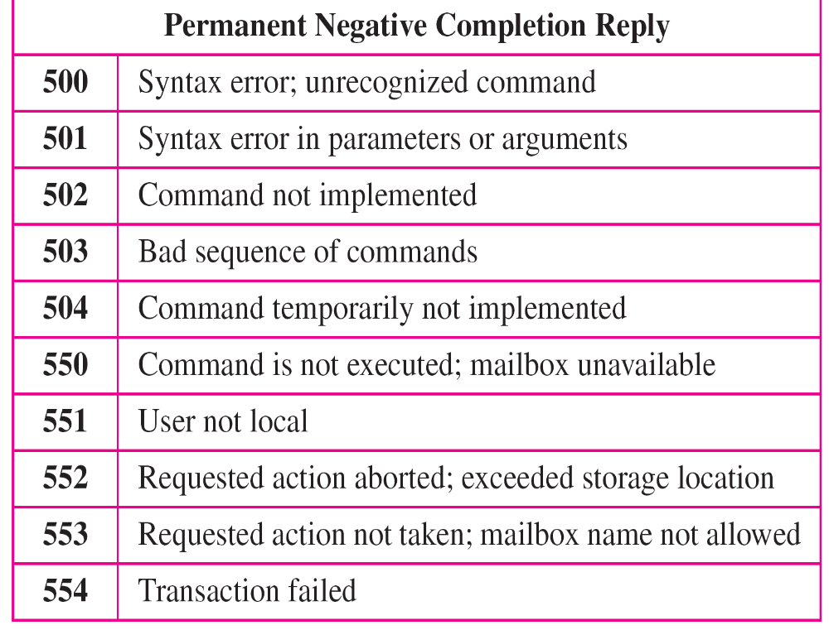
Message Transfer Agent: SMTP

Slide 47
Message Transfer Agent: SMTP
Mail Transfer Phases
  The process of transferring a mail message occurs in three phases
    Connection establishment
    Mail transfer
    Connection termination

Slide 48
File Transfer
Transferring files from one computer to another is one of the most common tasks expected from a networking or internetworking environment
The greatest volume of data exchange in the Internet today is due to file transfer

Slide 49
File Transfer Protocol (FTP)
FTP is the standard mechanism provided by TCP/IP for copying a file from one host to another
FTP differs from other client/server applications
It establishes two connections between the hosts
  One connection is used for data transfer
  The other for control information (commands and responses)
FTP uses two well-known TCP ports
  Port 21 is used for the control connection
  Port 20 is used for the data connection

Slide 50
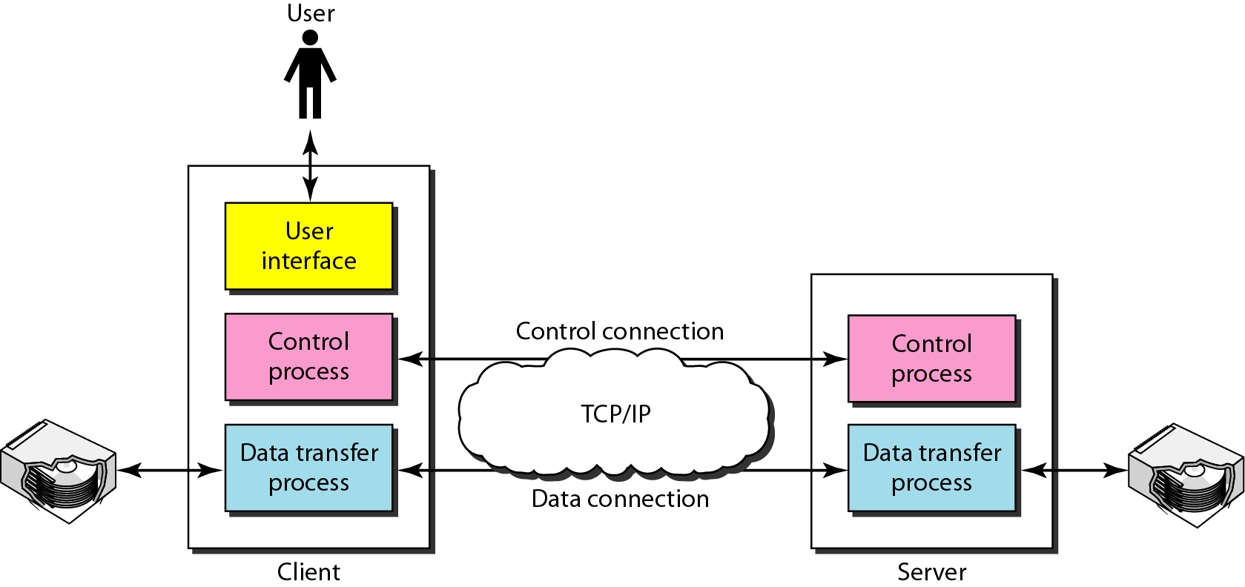
File Transfer Protocol (FTP)

Slide 51
File Transfer Protocol (FTP)
The client has three components
  User interface
  Client control process
  The client data transfer process
The server has two components
  The server control process
  The server data transfer process
The control connection is made between the control processes
The data connection is made between the data transfer processes

Slide 52
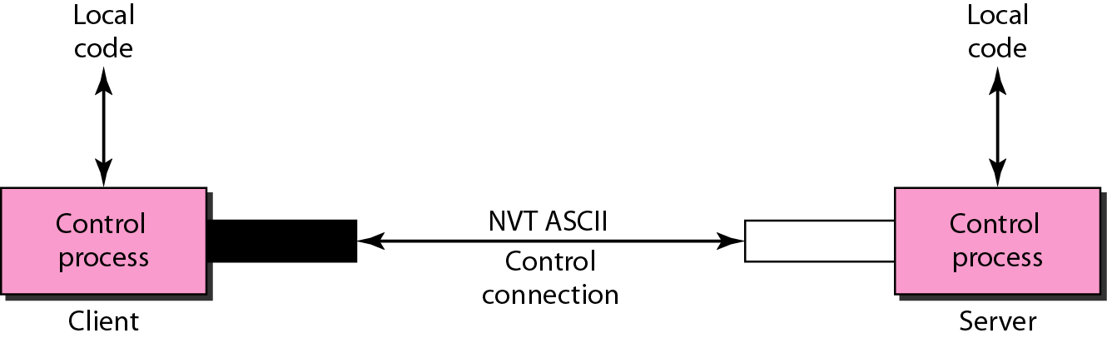
File Transfer Protocol (FTP)
Communication over Control Connection
  FTP uses the same approach as SMTP to communicate across the control connection
  It uses the 7-bit ASCII character set
  Communication is achieved through commands and responses

Slide 53
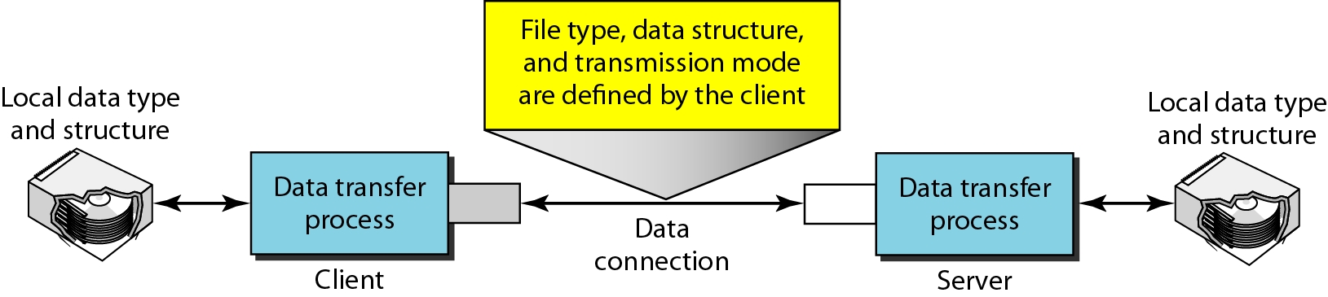
File Transfer Protocol (FTP)
Communication over Data Connection
  The purpose of the data connection is different from that of the control connection
  File transfer occurs over the data connection under the control of the commands sent over the control connection
The client must define the type of file to be transferred, the structure of the data, and the transmission mode

Slide 54
File Transfer Protocol (FTP)
File Type
  FTP can transfer one of the following file types across the data connection
    An ASCII file
      The ASCII file is the default format for transferring text files
    EBCDIC file
      If one or both ends of the connection use EBCDIC encoding , the file can be transferred using EBCDIC encoding
    Image file
      The image file is the default format for transferring binary files

Slide 55
File Transfer Protocol (FTP)
Data Structure
  FTP can transfer a file across the data connection by using one of the following interpretations about the structure of the data
    File structure
      In the file structure format, the file is a continuous stream of bytes
    Record structure
      In the record structure, the file is divided into records.
      This can be used only with text files
    Page structure
      In the page structure, the file is divided into pages, with each page having a page number and a page header

Slide 56
File Transfer Protocol (FTP)
Transmission Mode
  FTP can transfer a file across the data connection by using one of the following three transmission modes
    Stream mode
      The stream mode is the default mode.
      Data are delivered from FTP to TCP as a continuous stream of bytes
    Block mode
      In block mode, data can be delivered from FTP to TCP in blocks
    Compressed mode
      In the compressed mode, if the file is big, the data can be compressed

Slide 57
HTTP
The Hypertext Transfer Protocol (HTTP) is a protocol used mainly to access data on the World Wide Web
HTTP functions as a combination of FTP and SMTP

Slide 58
HTTP (Outline)
HTTP Transaction
Persistent Versus Nonpersistent Connection
Proxy Server

Slide 59
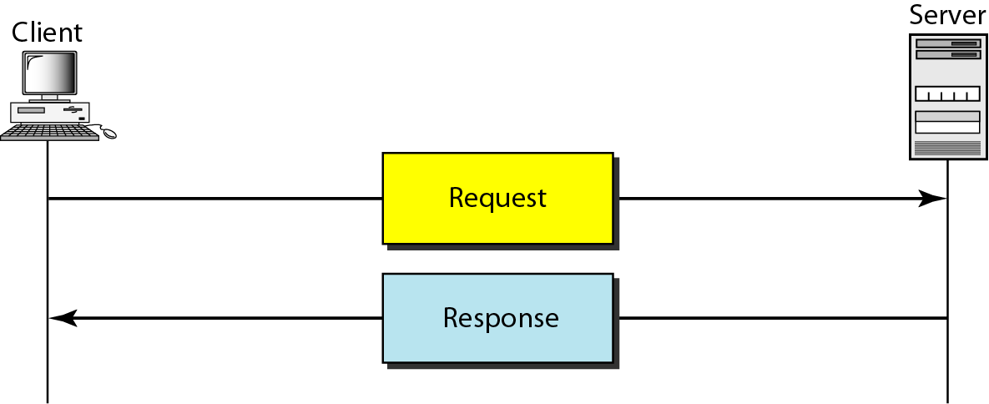
HTTP Transaction
HTTP transaction between the client and server
Although HTTP uses the services of TCP, HTTP itself is a stateless protocol
The client initializes the transaction by sending a request message
The server replies by sending a response

Slide 60
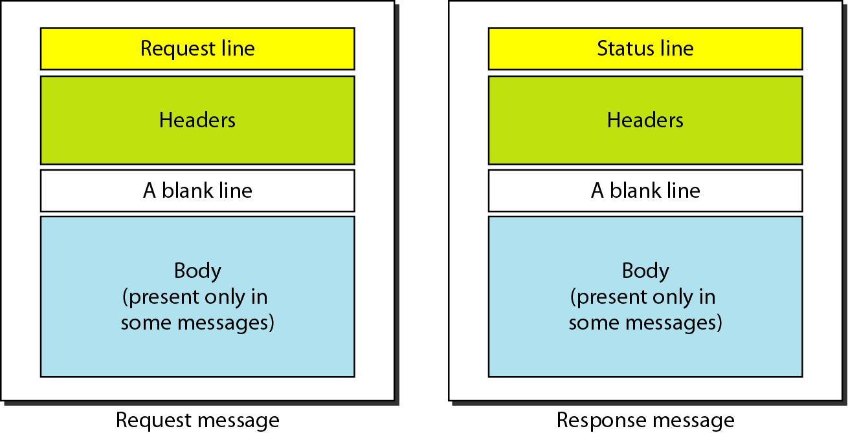
HTTP Transaction
Message

Slide 61
HTTP Transaction
Message
  The formats of the request and response messages are similar
  A request message consists of a request line, a header, and sometimes a body
  A response message consists of a status line, a header, and sometimes a body

Slide 62
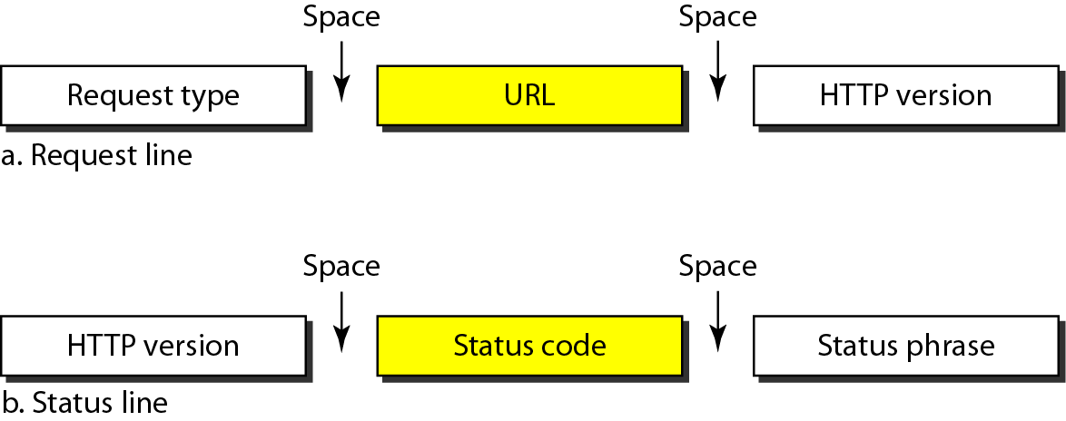
HTTP Transaction
Request Lines
  The first line in a request message is called a request line
  The first line in the response message is called the status line
  Request type
    This field is used in the request message
  Version
    The most current version of HTTP is 1.1

Slide 63
HTTP Transaction
Status Lines
  Status code
    It consists of three digits
      Informational (100 range)
      Success (200 range)
      Redirection (300 range)
      Client Error (400 range)
      Server Error (500 range)
  Status phrase
    This field is used in the response message
    It explains the status code in text form

Slide 64
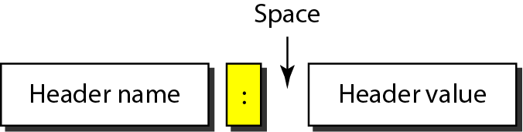
HTTP Transaction
Header
  The header exchanges additional information between the client and the server
  The header can consist of one or more header lines
  Each header line has
    A header name
    A colon
    A space
    A header value
  A header line belongs to one of four categories
    General header
    Request header
    Response header
    Entity header

Slide 65
HTTP Transaction
General header
  The general header gives general information about the message and can be present in both a request and a response
Request header
  The request header can be present only in a request message
  It specifies the client's configuration and the client's preferred document format
Response header
  The response header can be present only in a response message
  It specifies the server's configuration and special information about the request
Entity header
  The entity header gives infonnation about the body of the document

Slide 66
HTTP Transaction
Body
  The body can be present in a request or response message
  It contains the document to be sent or received

Slide 67
Persistent Versus Nonpersistent Connection
Persistent Connection
  HTTP version 1.1 specifies a persistent connection by default
  The server leaves the connection open for more requests after sending a response
  The server can close the connection at the request of a client or if a time-out has been reached
Nonpersistent Connection
  One TCP connection is made for each request/response
  The following lists the steps in this strategy:
    The client opens a TCP connection and sends a request
    The server sends the response and closes the connection
    The client reads the data until it encounters an end-of-file marker; it then closes the connection

Slide 68
Proxy Server
HTTP supports proxy servers
A proxy server is a computer that keeps copies of responses to recent requests
The HTTP client sends a request to the proxy server
The proxy server checks its cache
If the response is not stored in the cache, the proxy server sends the request to the corresponding server
Incoming responses are sent to the proxy server and stored for future requests from other clients
The proxy server reduces the load on the original server, decreases traffic, and improves latency

Slide 69
WWW
The World Wide Web (WWW) is a repository of information linked together from points all over the world
TheWWW has a unique combination of flexibility, portability, and user-friendly features that distinguish it from other services provided by the Internet

Slide 70
WWW
Architecture
Web Documnet

Slide 71
Architecture
TheWWW today is a distributed client/server service, in which a client using a browser can access a service using a server
However, the service provided is distributed over many locations called sites
Each site holds one or more documents, referred to as Web pages
Each Web page can contain a link to other pages in the same site or at other sites
The pages can be retrieved and viewed by using browsers

Slide 72

Architecture

Slide 73
Architecture
Client (Browser)
  Each browser usually consists of three parts
    A controller
      The controller receives input from the keyboard or the mouse and uses the client programs to access the document
    Client protocol
      The client protocol can be one of the protocols described previously such as FTP or HTIP
    Interpreters
      The interpreter can be HTML, Java, or JavaScript, depending on the type of document
Server
  The Web page is stored at the server
  Each time a client request arrives, the corresponding document is sent to the client

Slide 74
Architecture
Uniform Resource Locator (URL)
  A client that wants to access a Web page needs the address
  URL is a standard for specifying any kind of information on the Internet
  The URL defines four things
    Protocol
      The protocol is the client/server program used to retrieve the document
    Host computer
      The host is the computer on which the information is located
    Port
      The URL can optionally contain the port number of the server
    Path
      Path is the pathname of the file where the information is located

Slide 75
Architecture
Cookies
  Cookies are small files that websites put on your computer hard disk drive when you first visit
  A message given to a Web browser by a Wev server
  The browser stores the message in a text file
  The message is then sent back to the server each time the browser requests a page from the server
  The main purpose of cookies is to identify users and possibly prepare customized Web pages for them

Slide 76
Web Document
The documents in the WWWcan be grouped into three broad categories
  Static
  Dynamic
  Active

Slide 77
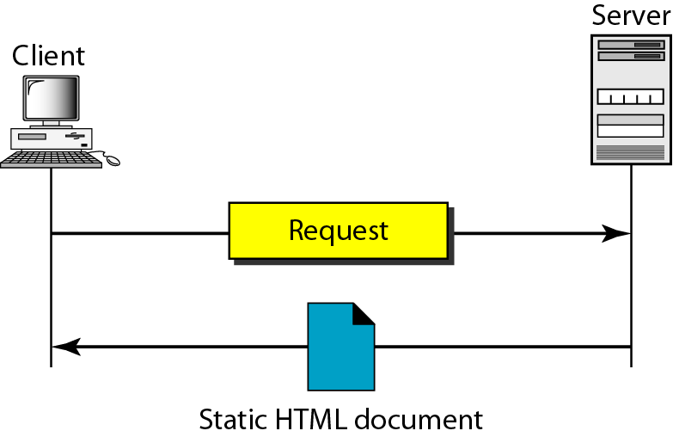
Web Document
Static Documents
  Static documents are fixed-content documents that are created and stored in a server
  HTML
    Hypertext Markup Language (HTML) is a language for creating Web pages

Slide 78
Web Document
Dynamic Documents
  A dynamic document is created by a Web server whenever a browser requests the document
  A very simple example of a dynamic document is the retrieval of the time and date from a server
  Common Gateway Interface (CGI)
    CGI is a technology that creates and handles dynamic documents.
  Scripting Technologies for Dynamic Documents
    A few technologies have been involved in creating dynamic documents using scripts
      Hypertext Preprocessor (pHP), which uses the Perl language
      Java Server Pages (JSP), which uses the Java language for scripting
      ActiveServer Pages (ASP), which uses Visual Basic language for scripting
      ColdFusion, which embeds SQL database queries in the HTML document

Slide 79
Web Document
Active Documents
  A program or a script to be run at the client site. These are called active documents
  Example, suppose we want to run a program that creates animated graphics on the screen or a program that interacts with the user
  Java Applets
    One way to create an active document is to use Java applets
  JavaScript
    The idea of scripts in dynamic documents can also be used for active documents

